Slide 1
Fraudulent Transactions Prediction
Miss Bindiya Anil Chavan.
Mr. Aniket Manohar More.
Mr. Shaik Irfan.
Mr. Gaurav Gupta.
Mr. G. Naveen Kumar.
Ms. Pooja Ravindra Patil.

Slide 2
Project Approach.
Business Understanding.
Data Understanding.
3
Data Preparation.
4
Modelling.
5
Evaluation.
2
1
Deployment
6

Slide 3
1. Business Understanding.
Fraud detection is a set of activities that are taken to prevent money or property from being obtained through false pretenses. Fraud can be committed in different ways and different settings.
For example, fraud can be committed in banking, insurance, government and healthcare sectors
A. Questions on key factors that fraudulent customer :
1. Mode of the payment.
2. Any disputes has been raised for the transactions.
3. Who is counterpart?
4. Any targeted counterparts
5. Any specific details in the Transaction notes
6. Open account/Closed Account
7. Time variable.
8. How is fraud flagged inferenced?
B. Question on model building:
1. What are the key factors that predict fraudulent customer?
2. How do you select variables to be included in the model?

Slide 4
2. Data Understanding.
About Dataset:-
• step - maps a unit of time in the real world. In this case 1 step is 1 hour of time. Total steps
744 (30 days simulation).
• type - CASH-IN, CASH-OUT, DEBIT, PAYMENT and TRANSFER.
• amount - amount of the transaction in local currency.
• nameOrig - customer who started the transaction
• oldbalanceOrg - initial balance before the transaction
• newbalanceOrig - new balance after the transaction
• nameDest - customer who is the recipient of the transaction
• oldbalanceDest - initial balance recipient before the transaction. Note that there is not
information for customers that start with M (Merchants).
• newbalanceDest - new balance recipient after the transaction. Note that there is not
information for customers that start with M (Merchants).
• isFraud - This is the transactions made by the fraudulent agents inside the simulation. In this
specific dataset the fraudulent behavior of the agents aims to profit by taking control or
customers accounts and try to empty the funds by transferring to another account and then
cashing out of the system.
• isFlaggedFraud - The business model aims to control massive transfers from one account to
another and flags illegal attempts. An illegal attempt in this dataset is an attempt to transfer
more than 200.000 in a single transaction

Slide 5
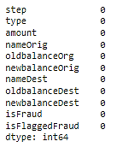
2. Data Understanding.
Data Shape : (14247, 11)
Null Values : There are no Null values.
There are no duplicate values in data set.

Slide 6
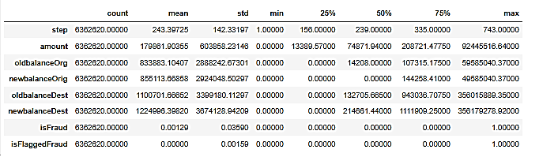
2. Data Understanding.
Statistical Description of Data.

Slide 7
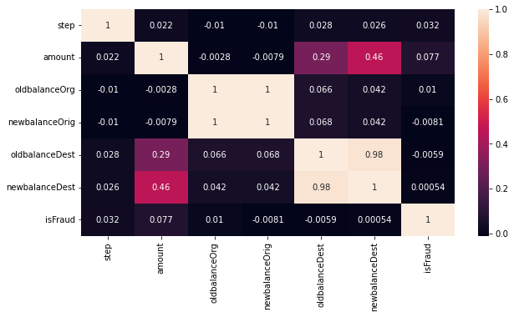
3. Data Preparation.
Finding Co-relation between variables.

Slide 8
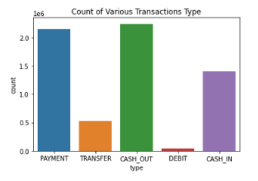
4. Data Visualisation.
Count of Various Transactions Type.

Slide 9
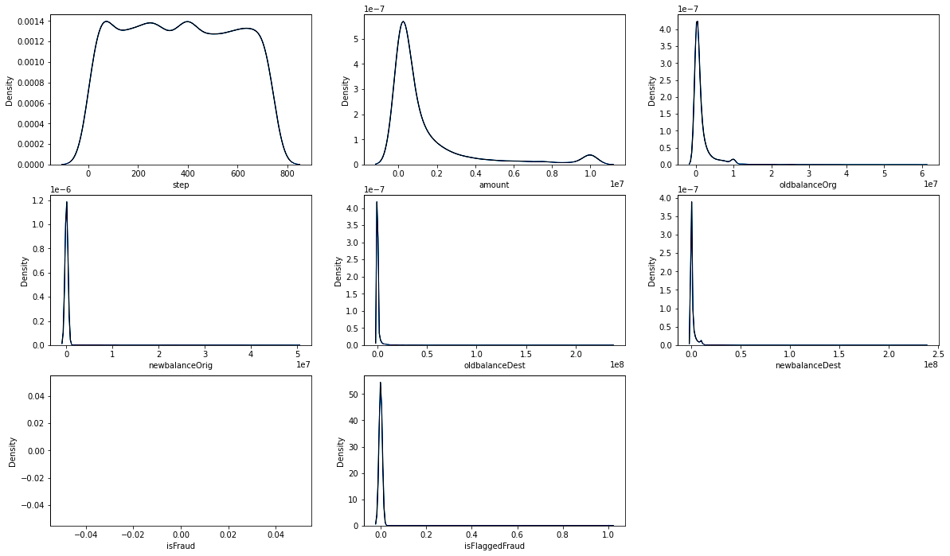
4. Data Visualisation.

Slide 10
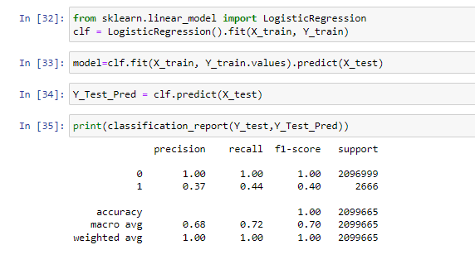
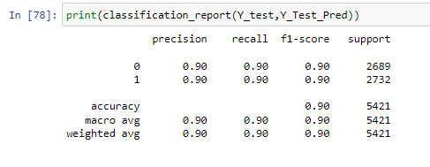
4. Modelling.
Logistic Regression
Before Under sampling
Accuracy Was 0.99%
After Under sampling
Accuracy was 0.90%

Slide 11
4. Model Accuracies
Logistic Regression : 90.09%
Random Forest Classifier : 98.96%
Decision Tree Classifier : 96.97%
XGBoost : 96.88%

Slide 12
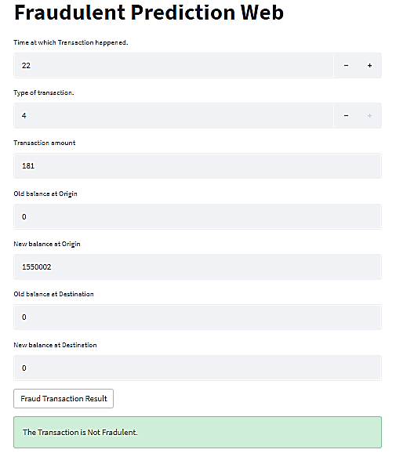
6. Deployment.

Slide 13
7. Conclusion
Fraud Detection system has become essential for banks and financial institutions, to minimize
their losses
We designed a system to detect fraud in transaction. This system is capable of providing most of
the essential features required to detect fraudulent and legitimate transactions
The dataset contains fraudulent transactions. A study is requested from us to predict whether
transaction is fraud or not by using the data.
First of all to observe the structure of the data, outliers, missing values and features that affect
the target variable, exploratory data analysis(EDA) and data visualization techniques.
Then, we performed data pre-processing operations to understand the data and their correlations
After that we built the models to predict whether the transaction is fraud or not, we trained the models
with train data, and tested it with test data.
In this process we used modeling with Logistic regression, Random forest classifier, Decision Tree
classifier. We used scikit learn Classification report for accuracy calculations and seaborn & matplotlib
for visualizations.
Then we get to know that all the models are giving almost 0.99% accuracy so we used undersampling
technique on our imbalanced dataset to balance it.
Then after comparing all the models we conclude that Logistic regression gave us the best accuracy.
so we saved the logistic regression as our final model
with this model we Deployed it via Streamlit.

Slide 14
7. Github Links
1.Aniket More :
https://github.com/HeyAniket22/Fraudulent_Transactions_Prediction
2. Bindiya Chavan.
https://github.com/Bindiya3/Fraudulent-Transaction-prediction

Slide 15
Thank You.

